Slide 1
Mobile Application Development
David Drohan (ddrohan@wit.ie)

Slide 2
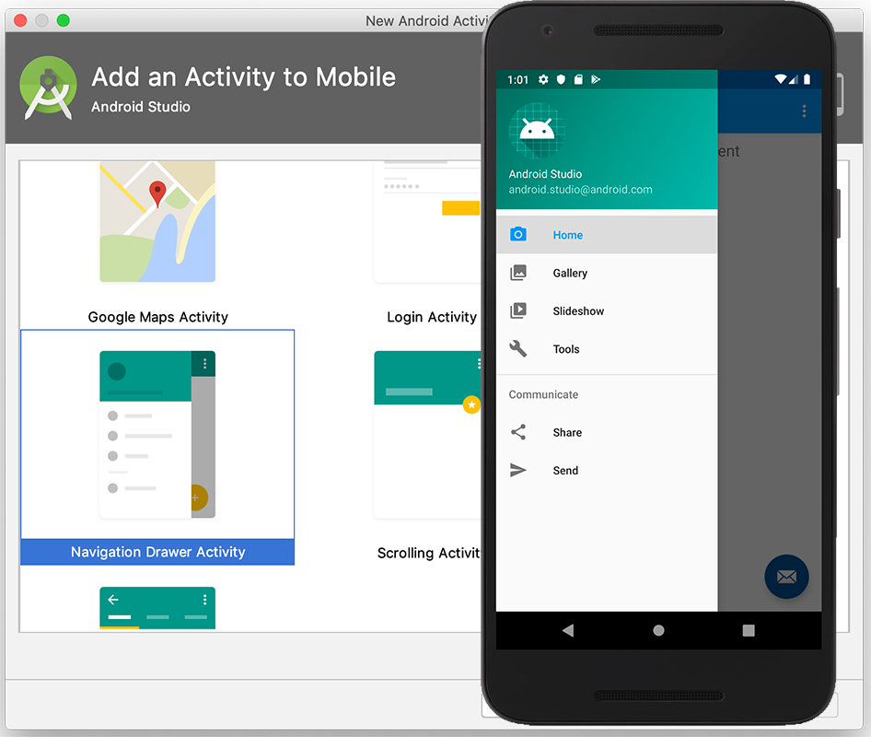
DonationX Walkthrough

Slide 3
Agenda
Navigation Component usage in DonationX
Initial Setup Look
Code Extracts from DonationX

Slide 4
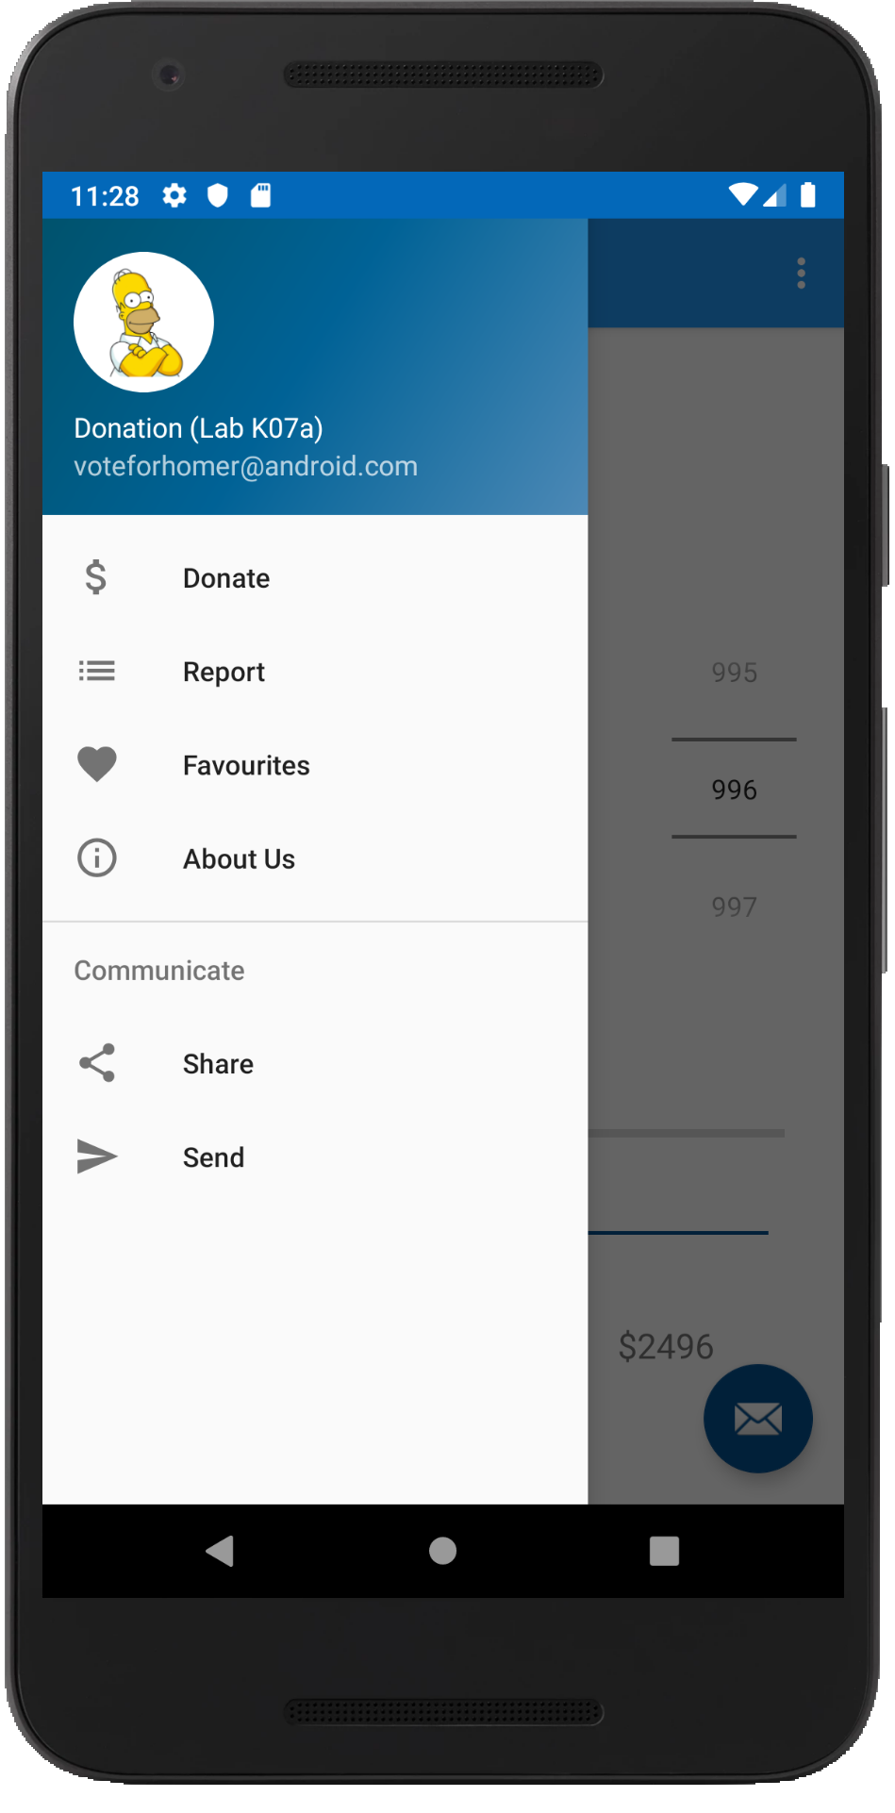
Case Study
An Android App to keep track of donations made to ‘Homers Presidential Campaign ’.
App Features
Accept donation via number picker or typed amount
Keep a running total of donations
Display report on donation amounts and types
Display running total on progress bar

Slide 5

Nav Drawer in DonationX
Auto Setup (via Navigation Component)

Slide 6
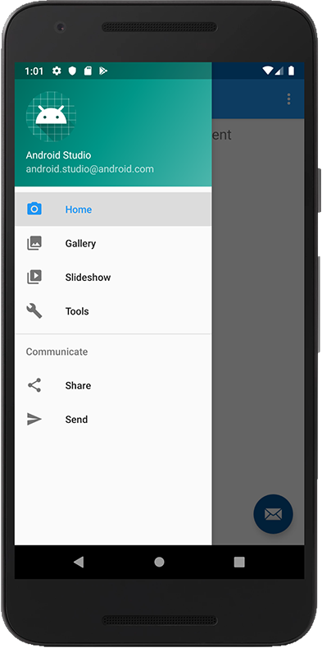
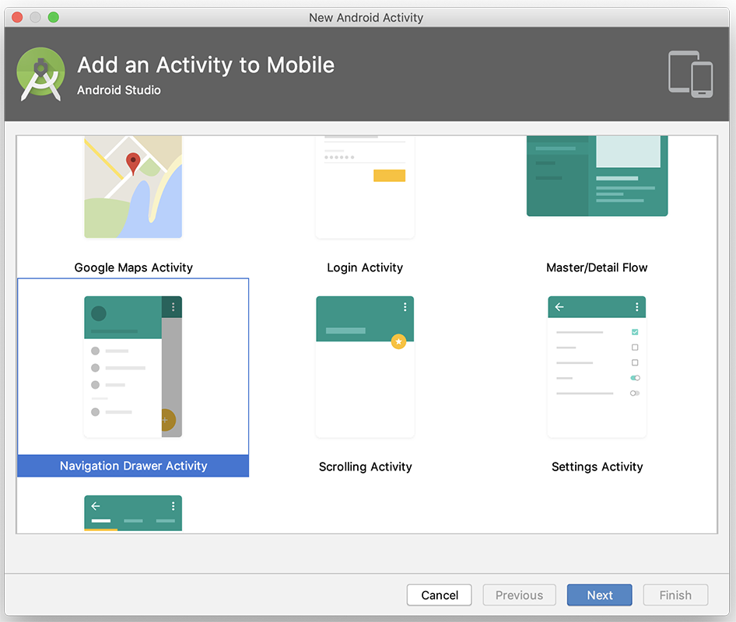
Initial Setup

Slide 7
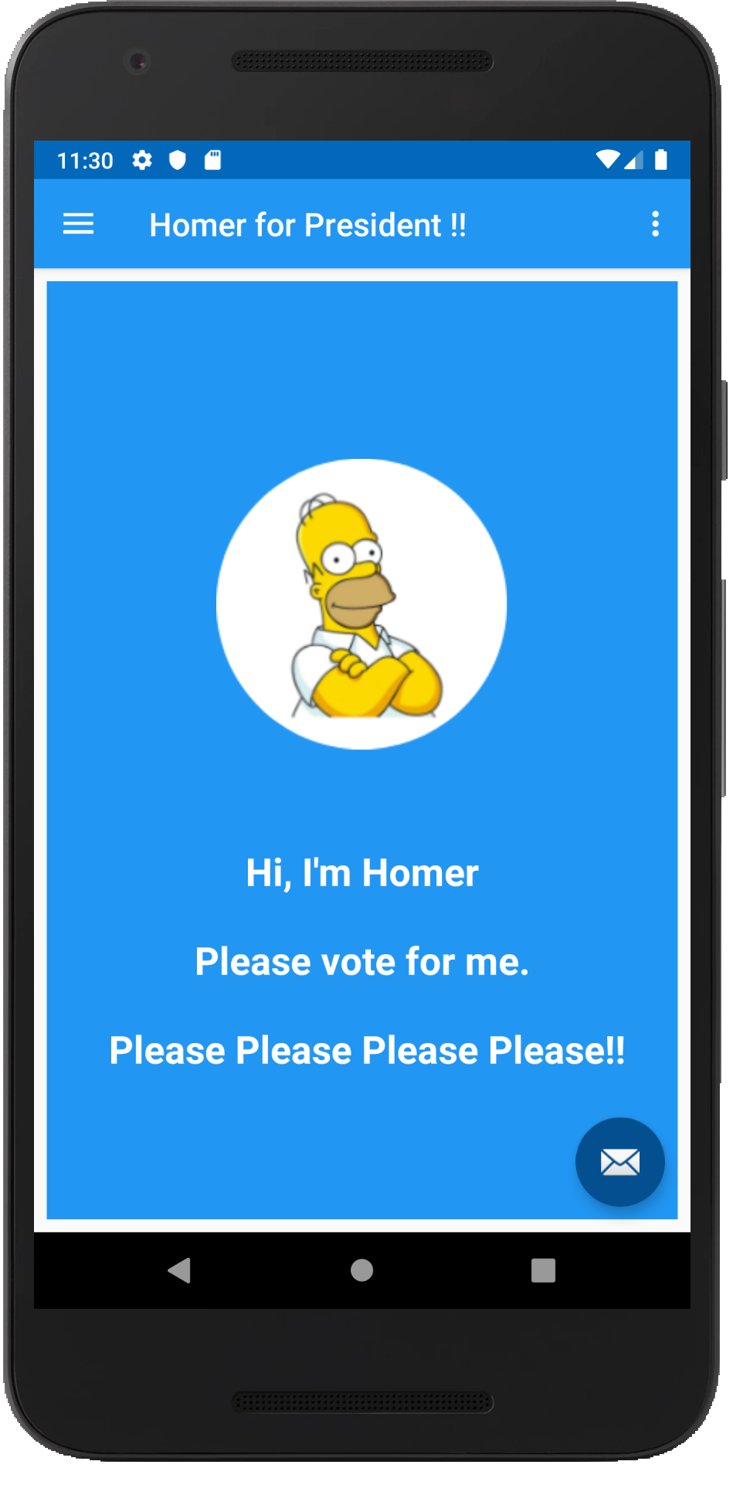
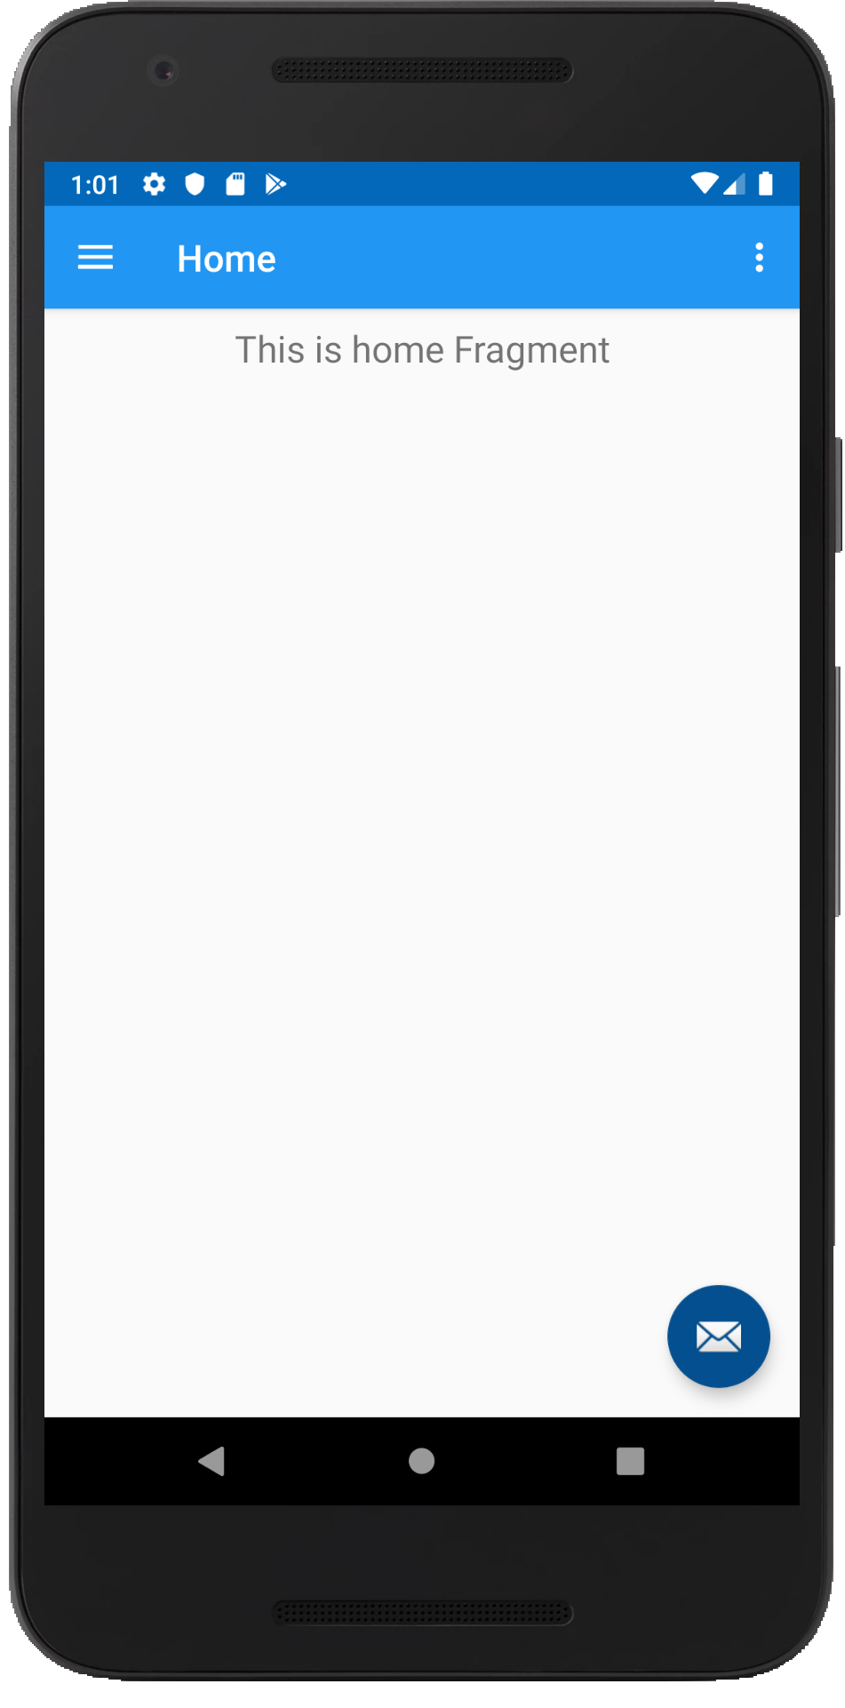
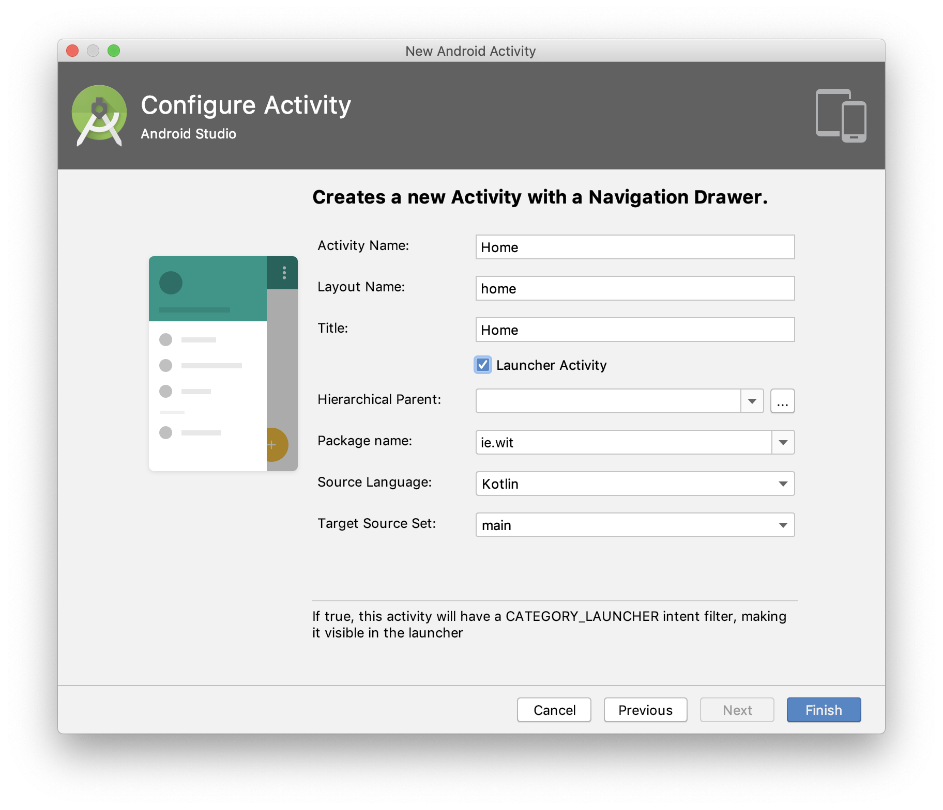
Initial Setup

Slide 8
What Do You Get? (errors in strings.xml & dimens.xml for a start ☺)

Slide 9
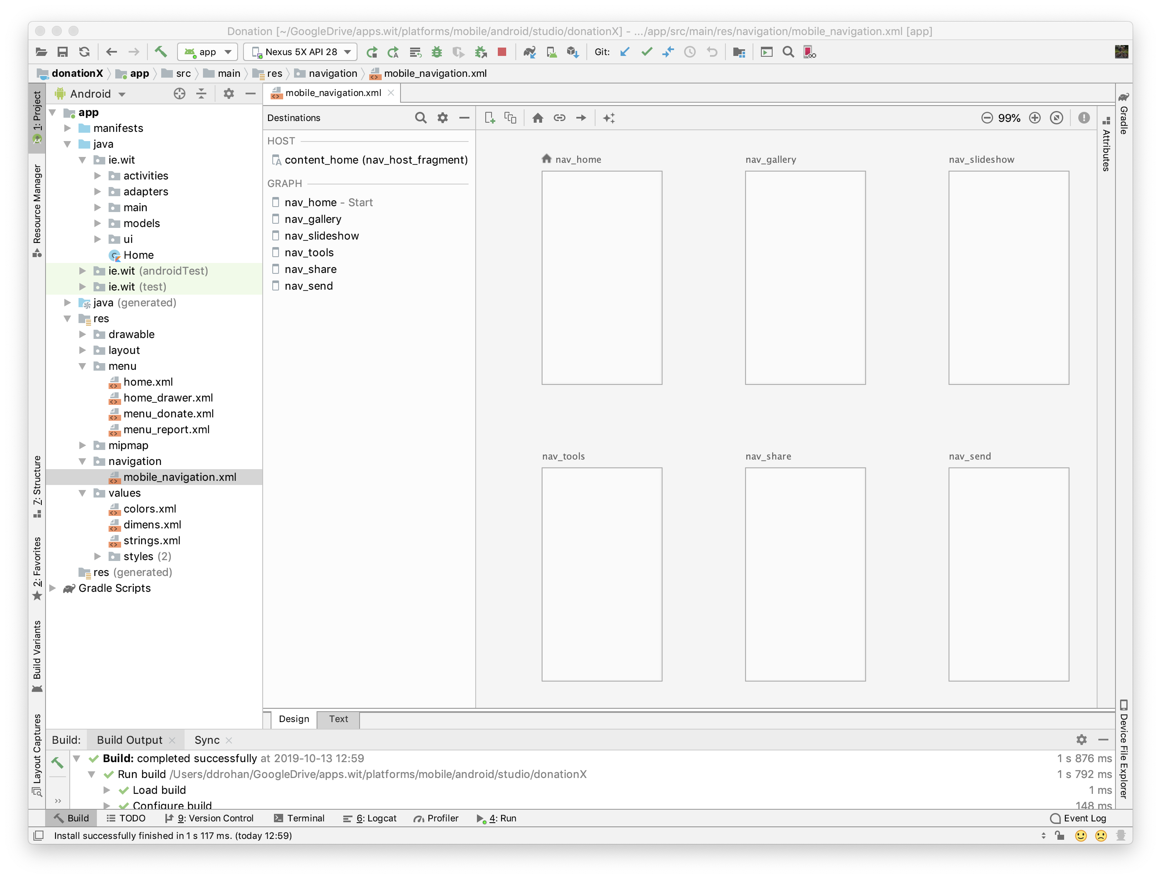
Navigation Graph
Navigation destinations & actions (none yet)

Slide 10
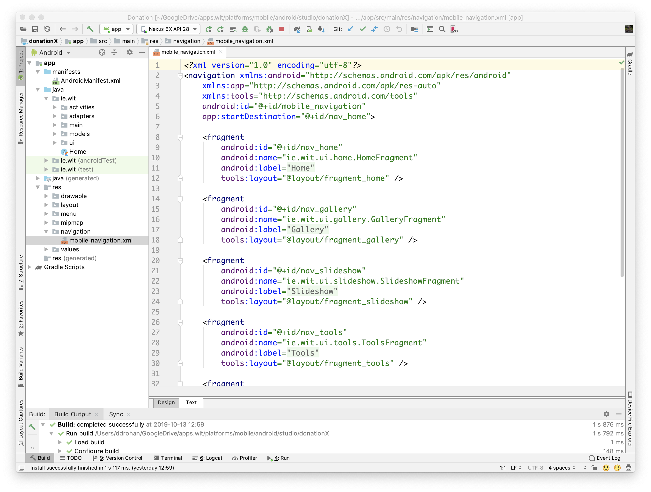
Navigation Graph
Navigation destinations & actions (none yet)
Fragment Setup

Slide 11
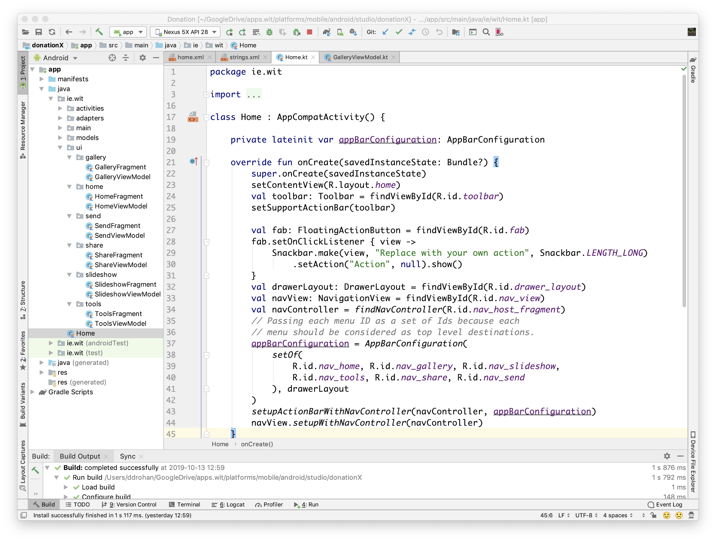
Various Classes
Home

Slide 12
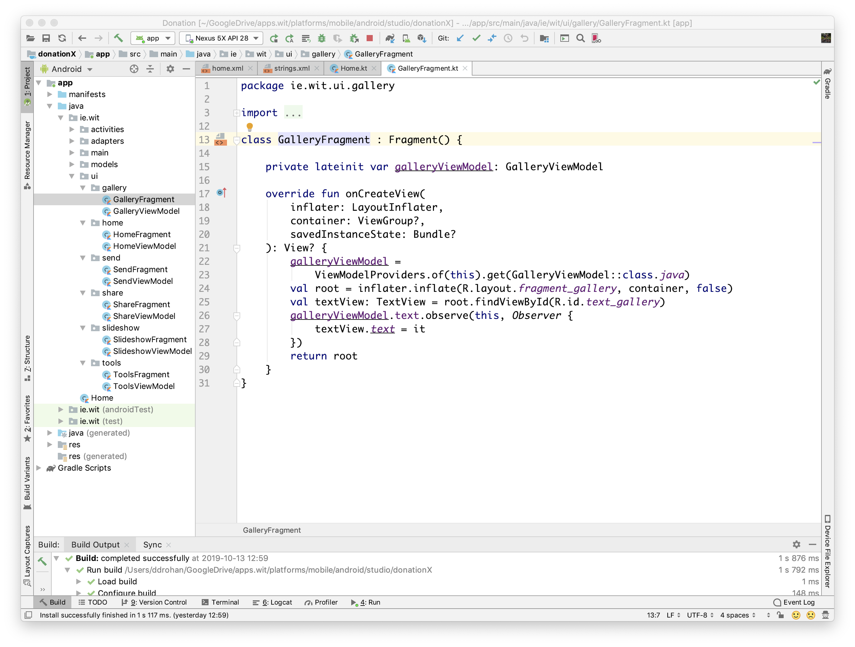
Various Classes
Gallery GalleryFragment GalleryViewModel

Slide 13
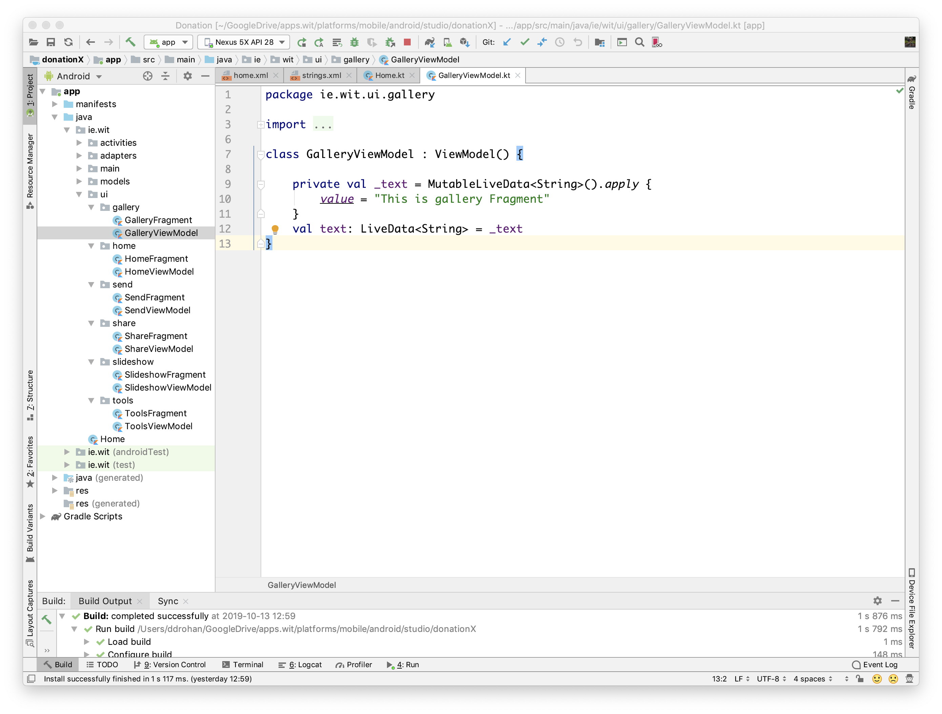
Various Classes
Gallery GalleryFragment GalleryViewModel
Ditto for the rest

Slide 14
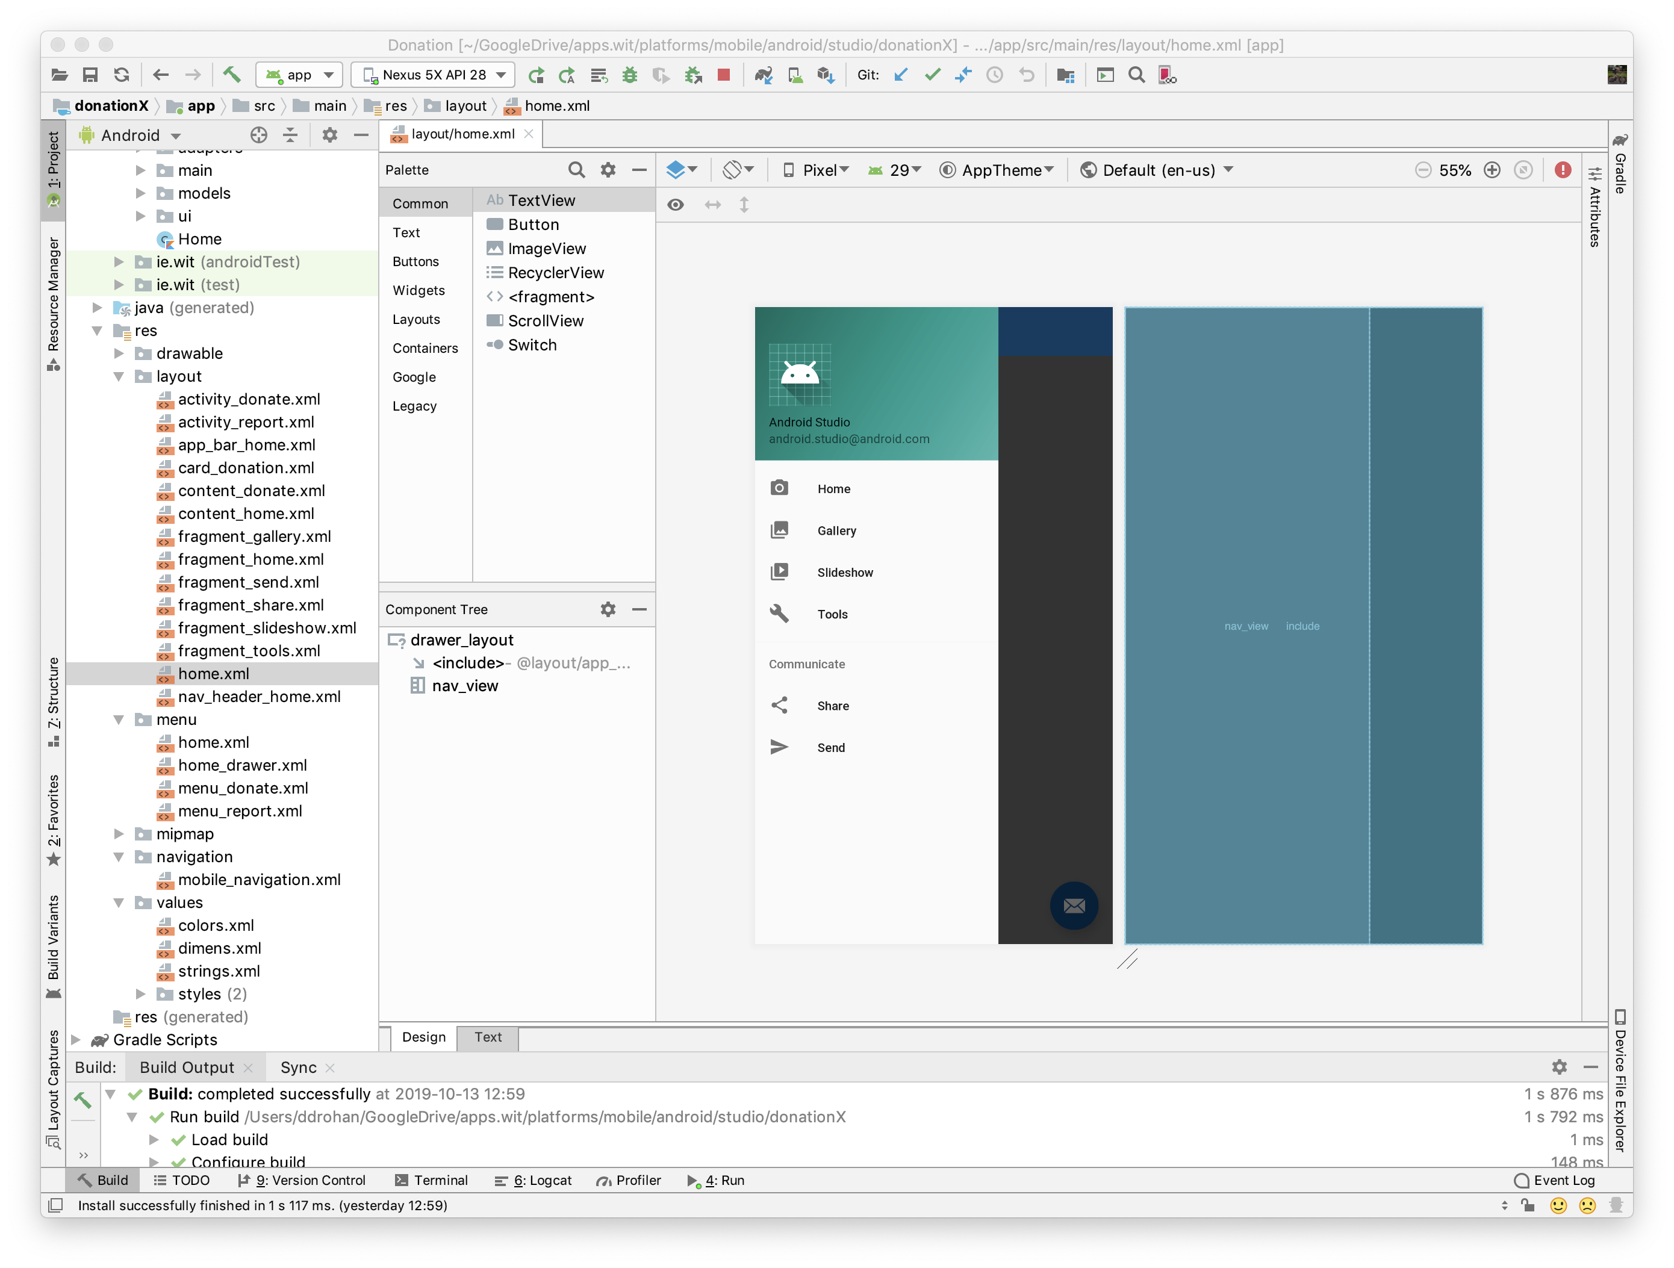
Various Layouts
home.xml

Slide 15
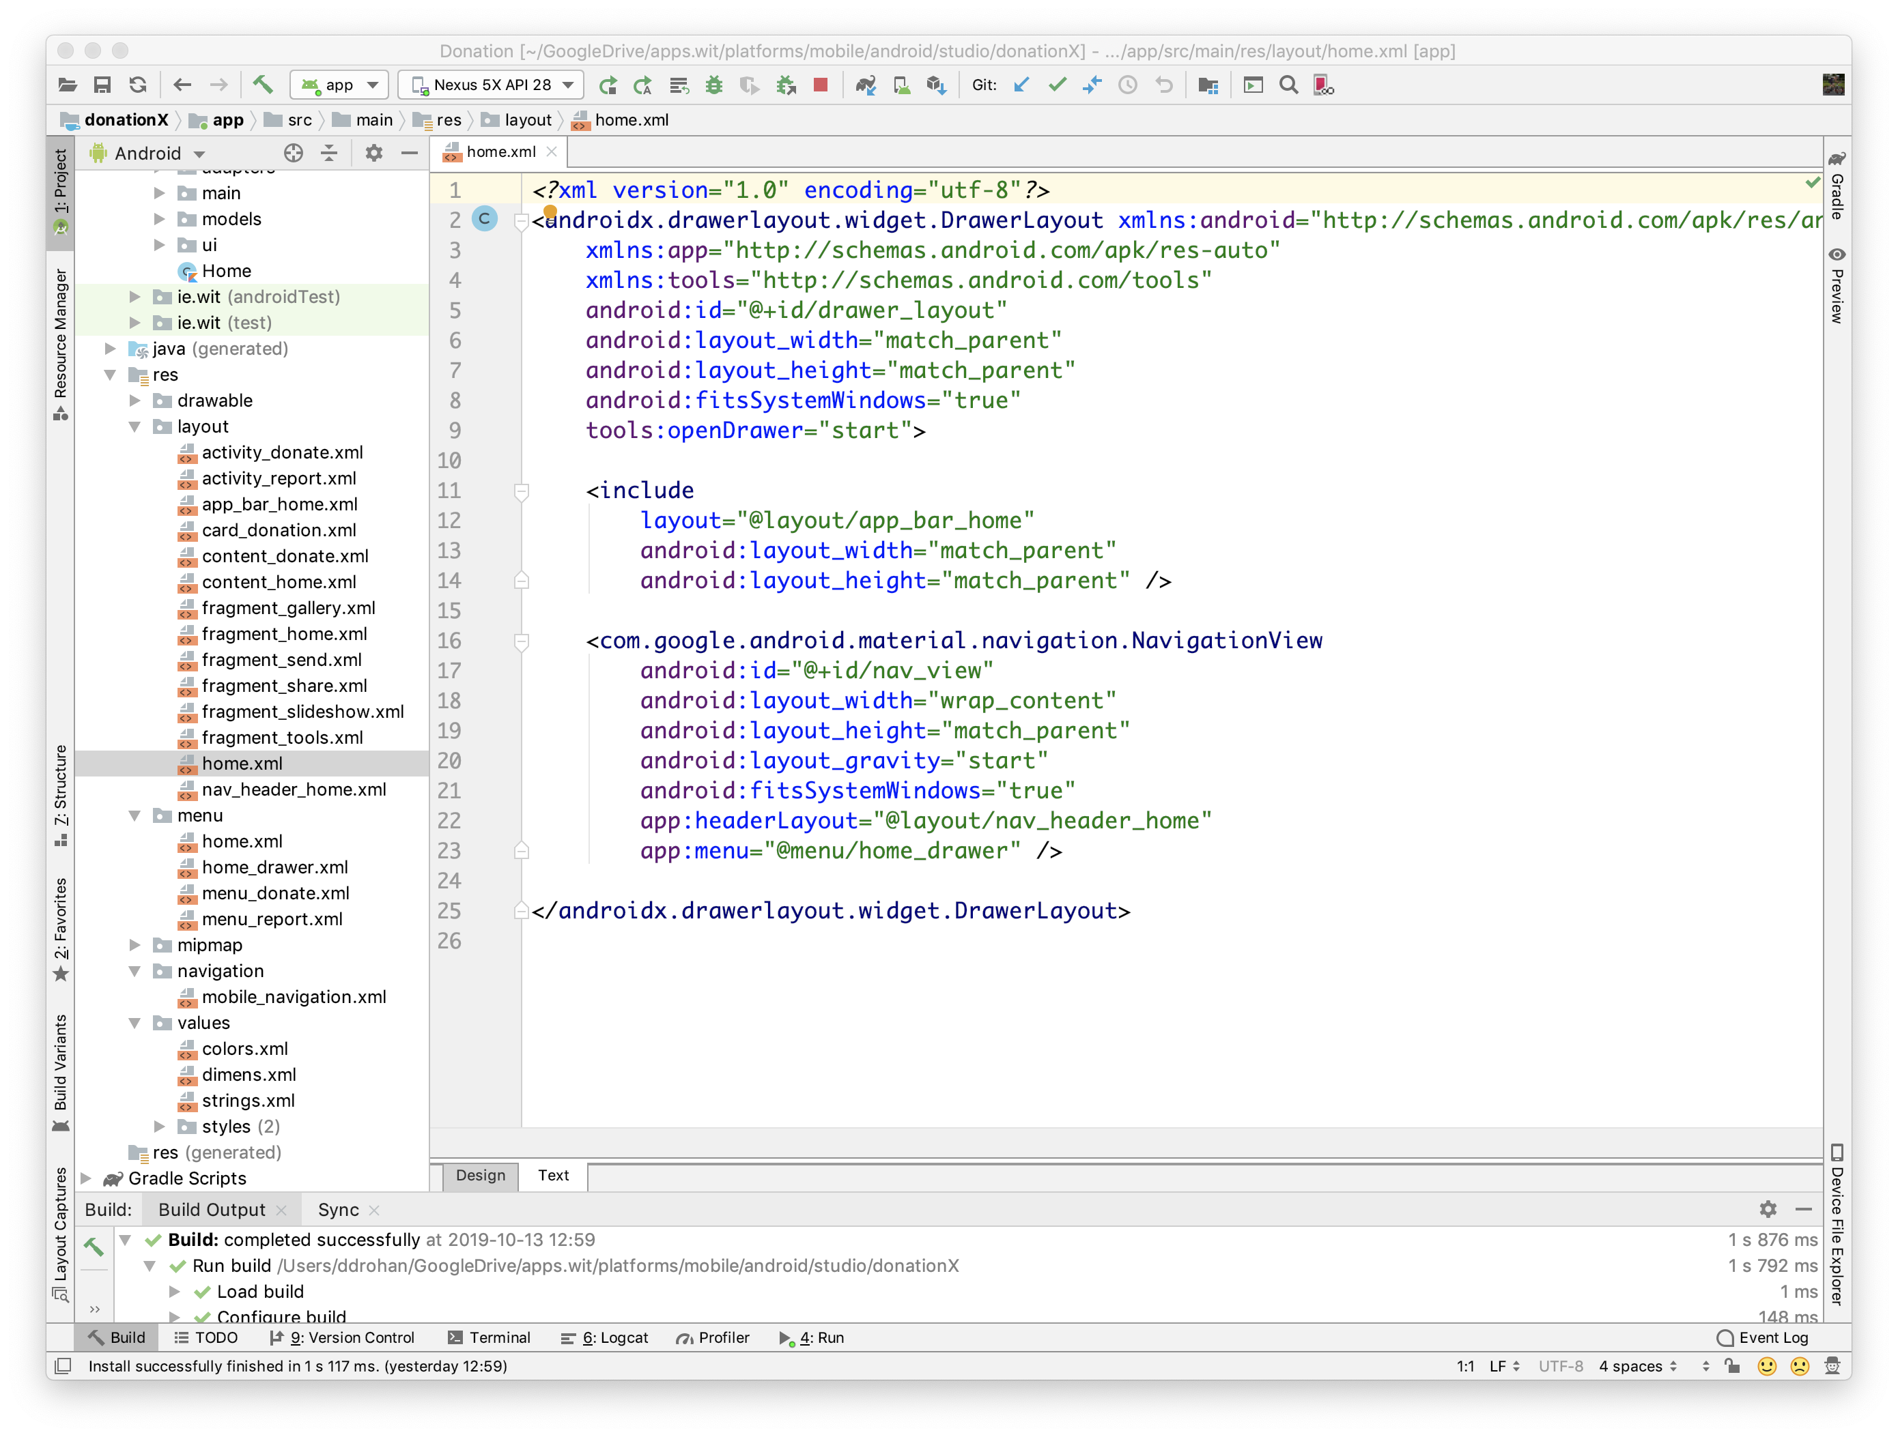
Various Layouts
home.xml

Slide 16
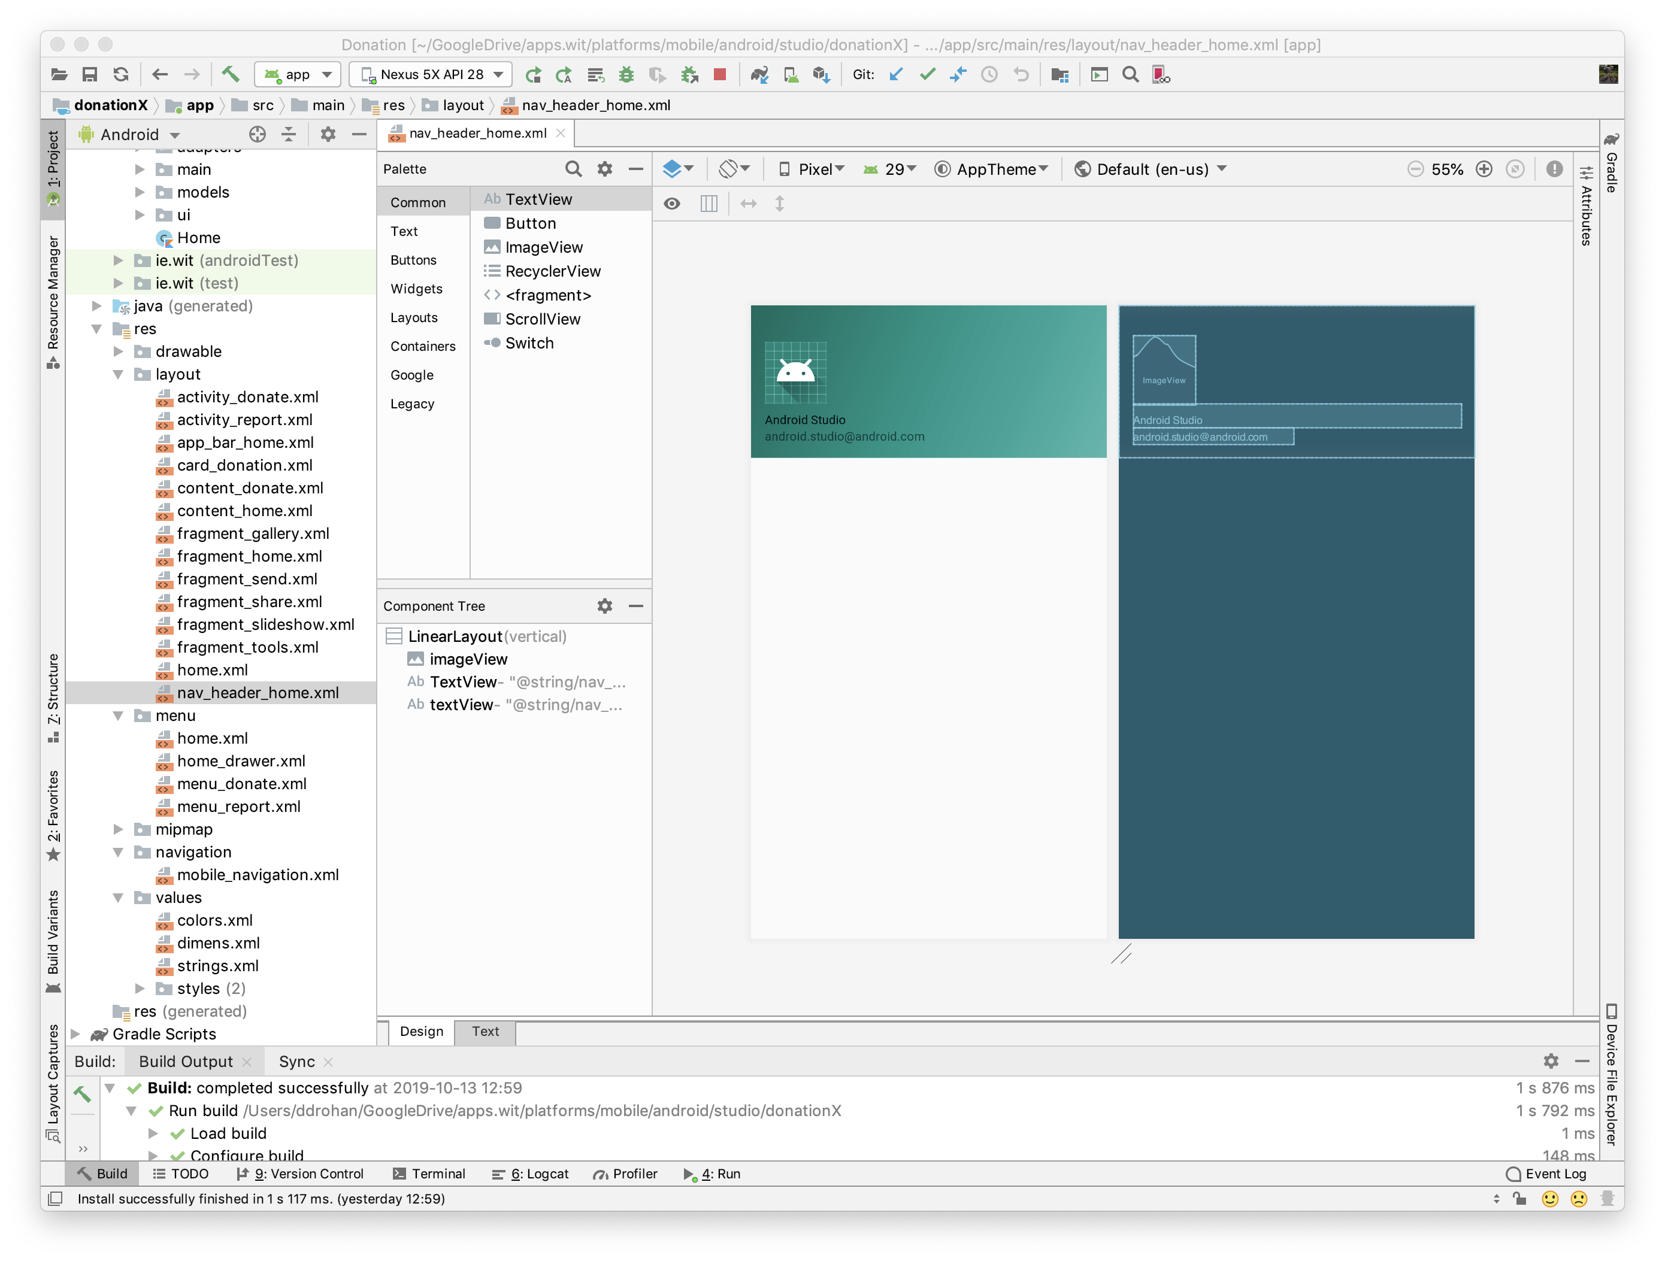
Various Layouts
nav_header_ home.xml

Slide 17
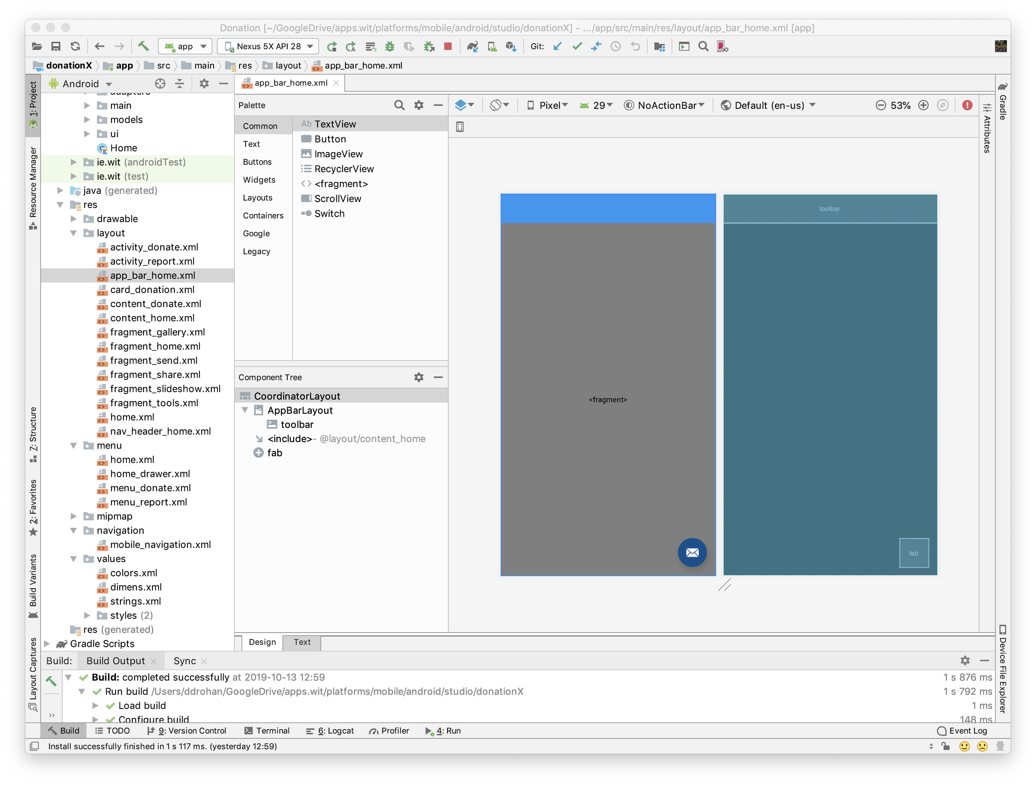
Various Layouts
app_bar_ home.xml

Slide 18
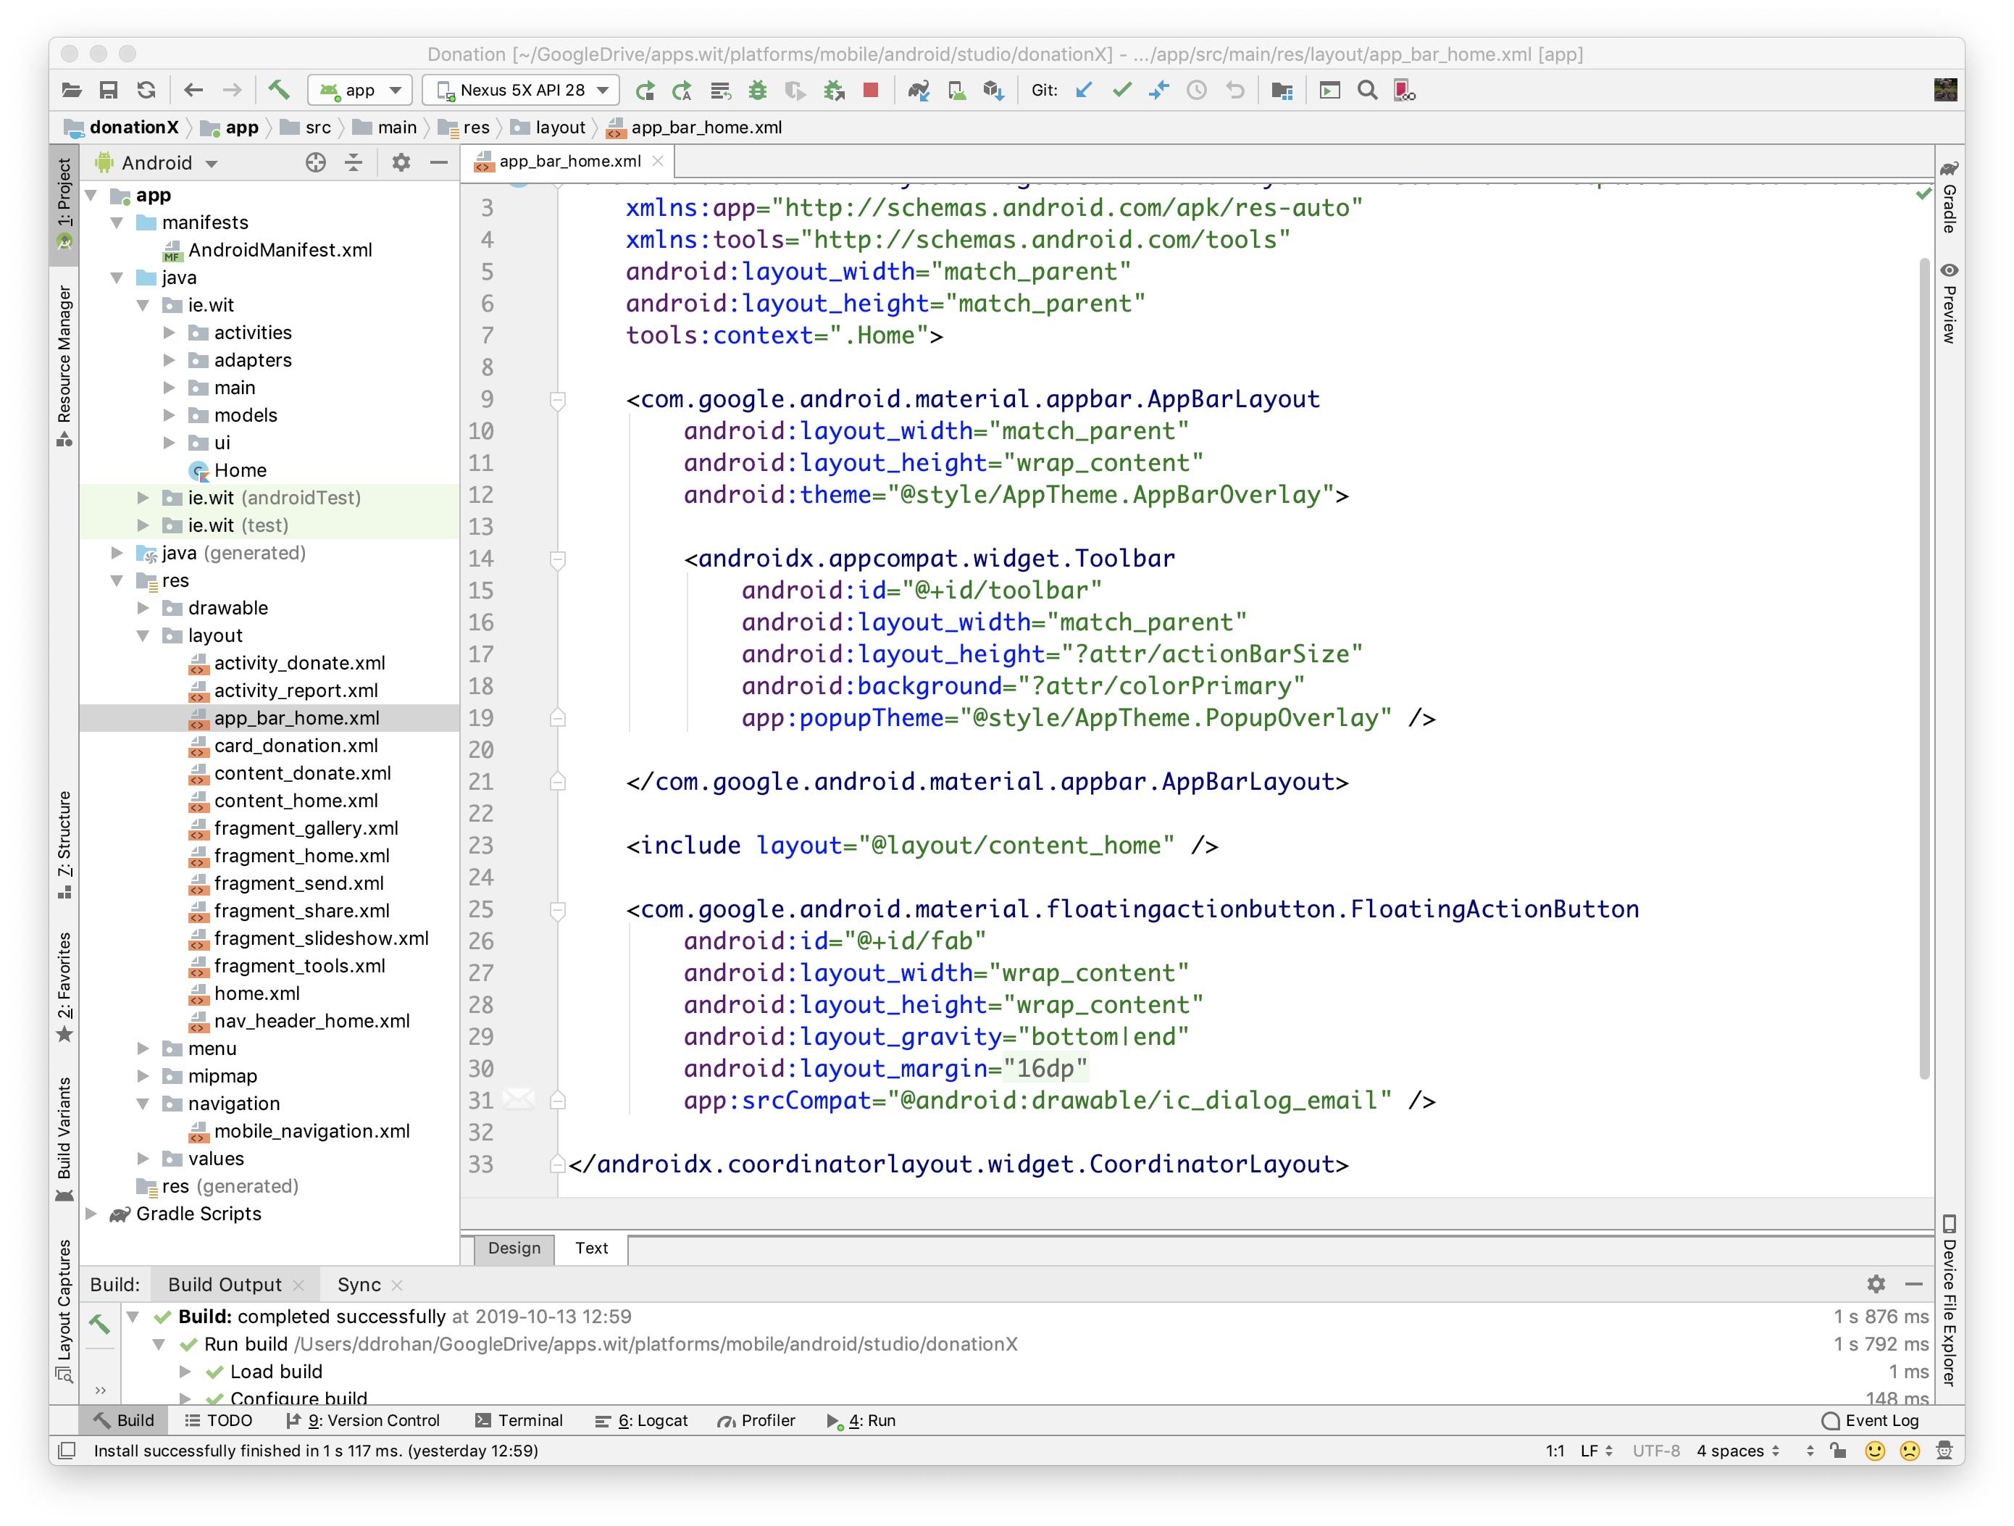
Various Layouts
app_bar_ home.xml

Slide 19
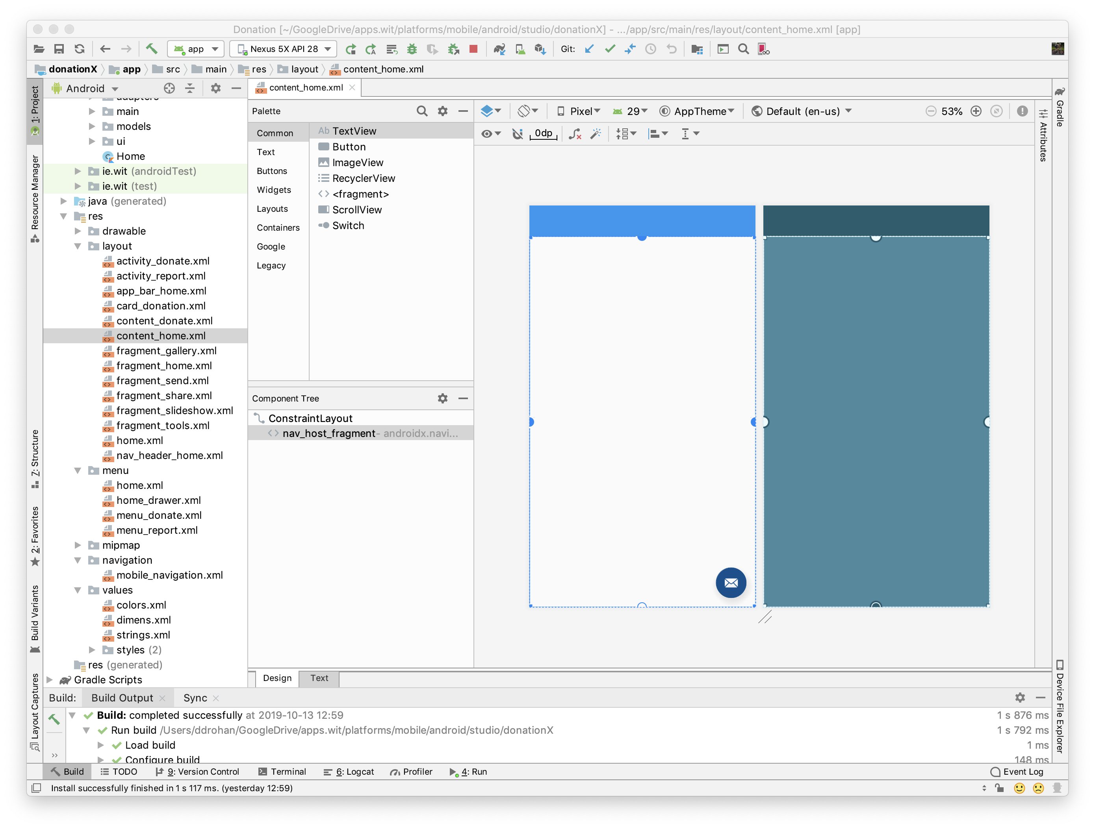
Various Layouts
content_ home.xml
‘links up’ with navigation graph

Slide 20
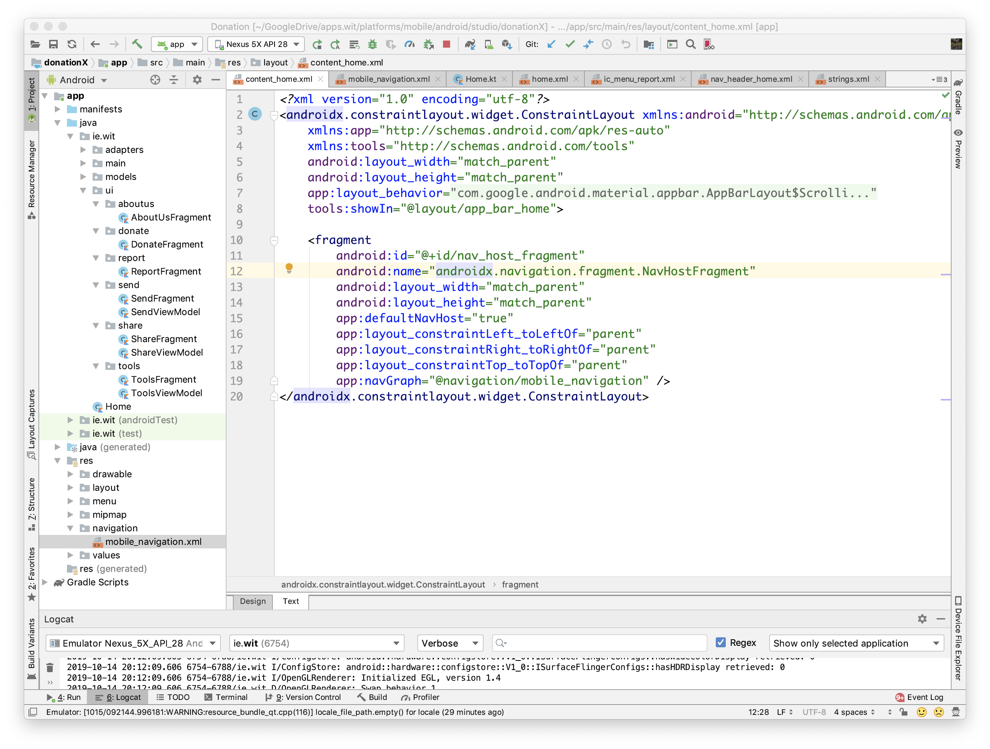
Various Layouts
content_ home.xml
‘links up’ with navigation graph

Slide 21
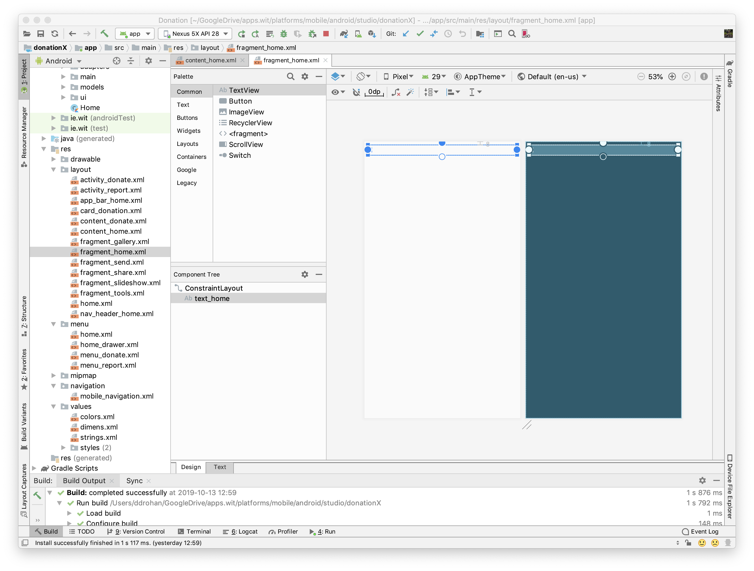
Various Layouts
fragment_ home.xml
Ditto for gallery, slideshow, tools, share, send

Slide 22
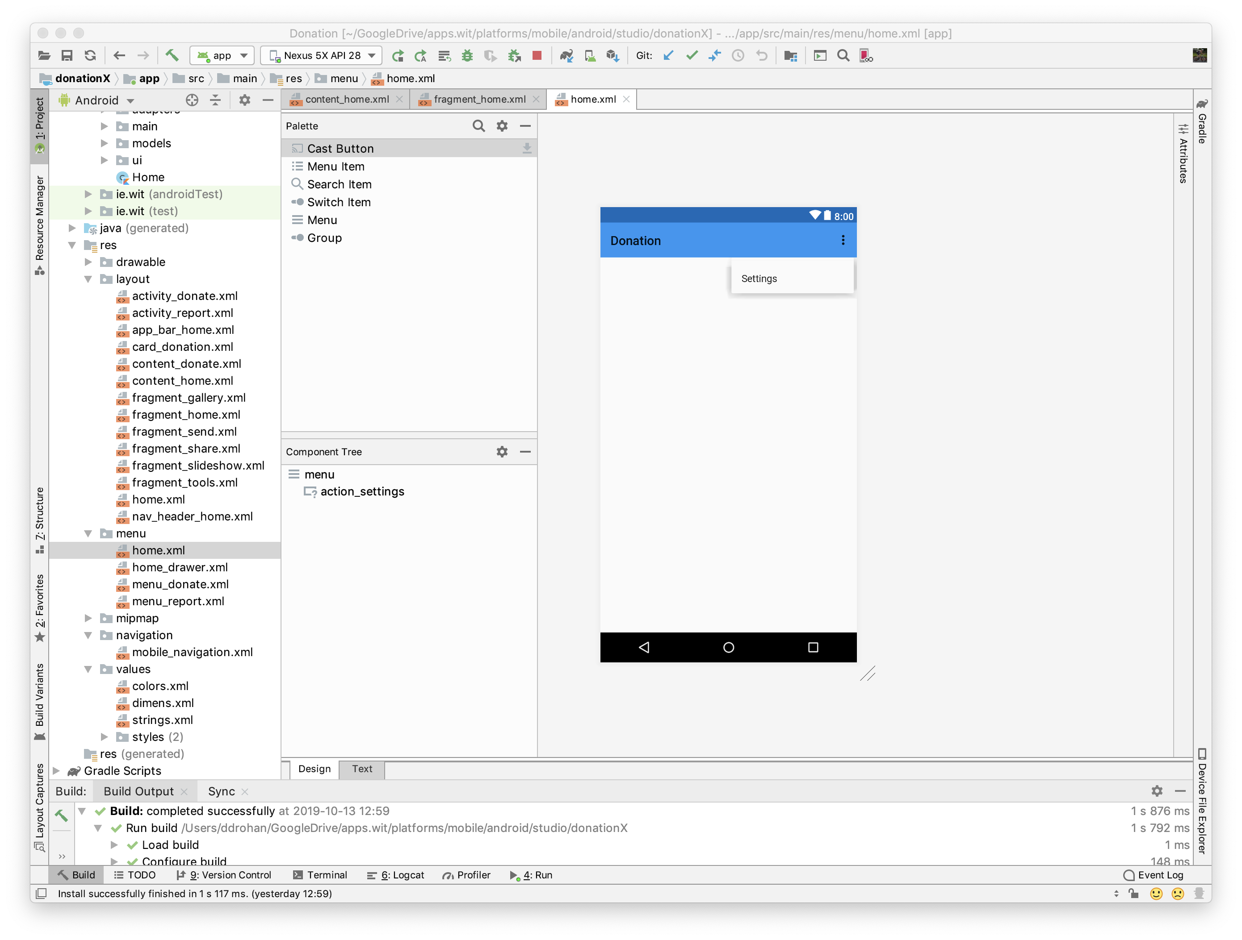
Various Menus
home.xml

Slide 23
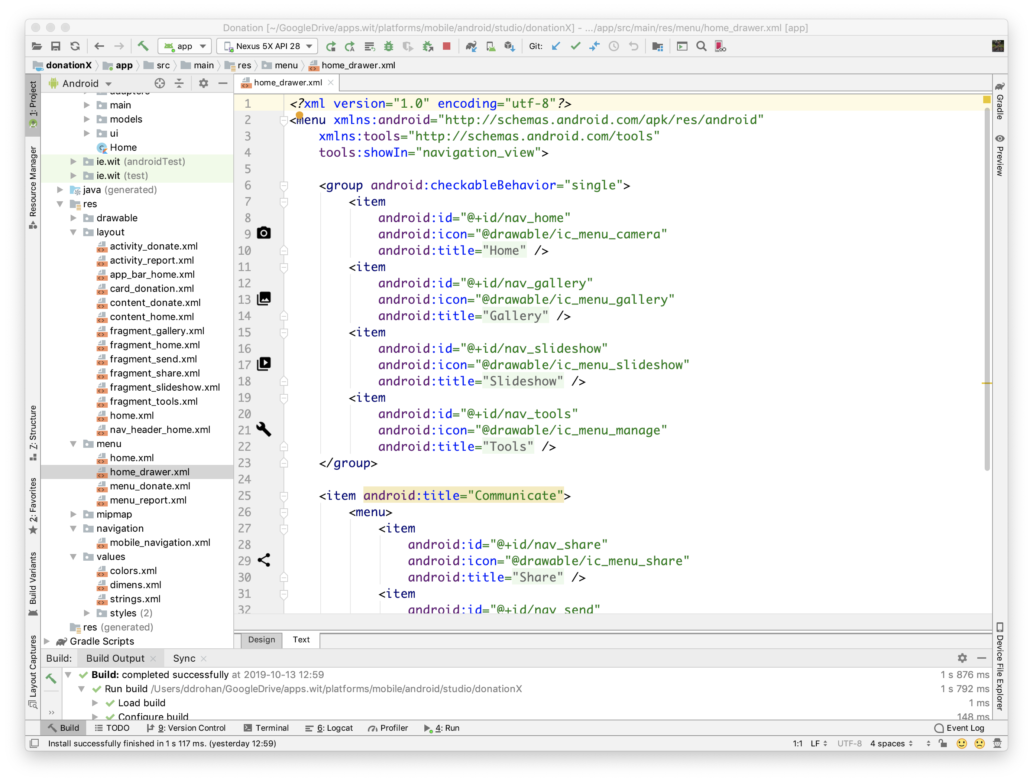
Various Menus
home_ drawer.xml

Slide 24
Initial Setup

Slide 25
Navigation Drawer Overview
Android Studio (and the Navigation Library) does a lot of the heavy lifting for you, but generally the following steps are necessary to add a Navigation Drawer to your app
Create drawer layout
Bind to navigation drawer layout
Handle navigation drawer click and
Update content based on user selection
Let’s compare….

Slide 26
Overview - Create Drawer Layout
Done (you just need to change it to suit your app, or maybe not? ☺)

Slide 27
Overview – Bind to the Drawer Layout etc.
Bind to the Drawer and Navigation View to allow you to handle the user navigation and switching content based on user selection…
Done

Slide 28
Overview – Bind to the Drawer Layout etc.
Display some kind of initial landing page once the app starts – Done
( after simply replacing the ‘Home’ fragment and layout with our own ‘Donate’ logic and layout )

Slide 29
Overview – Handle Drawer Click & Update Content
Done

Slide 30
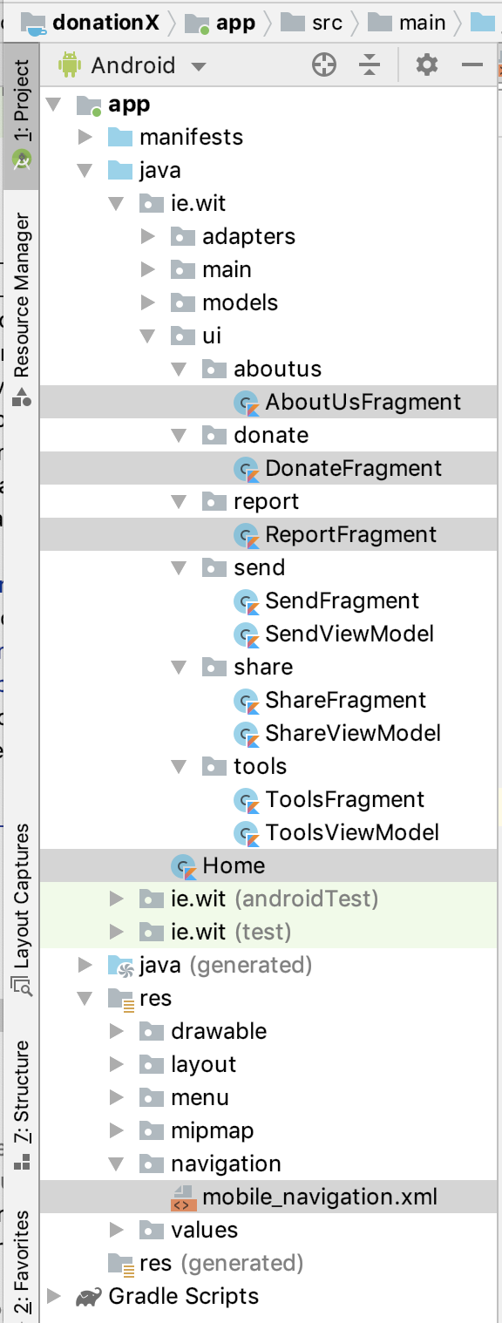
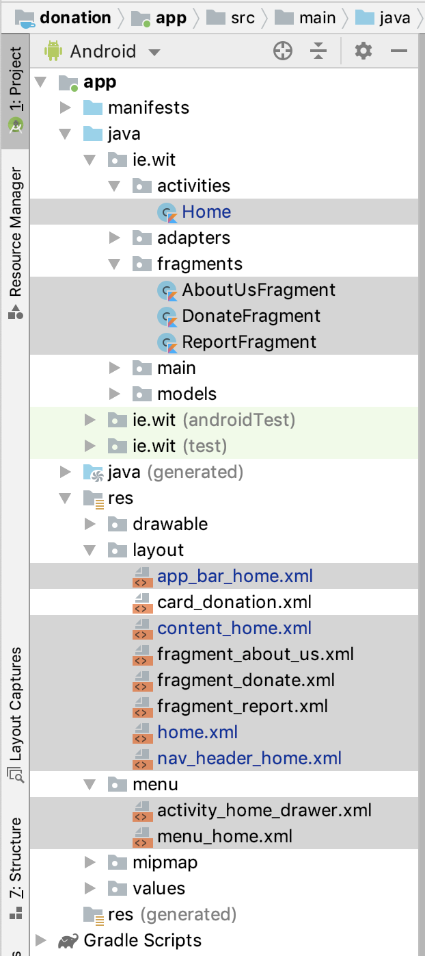
Projecture Structure
DonationX
Donation

Slide 31
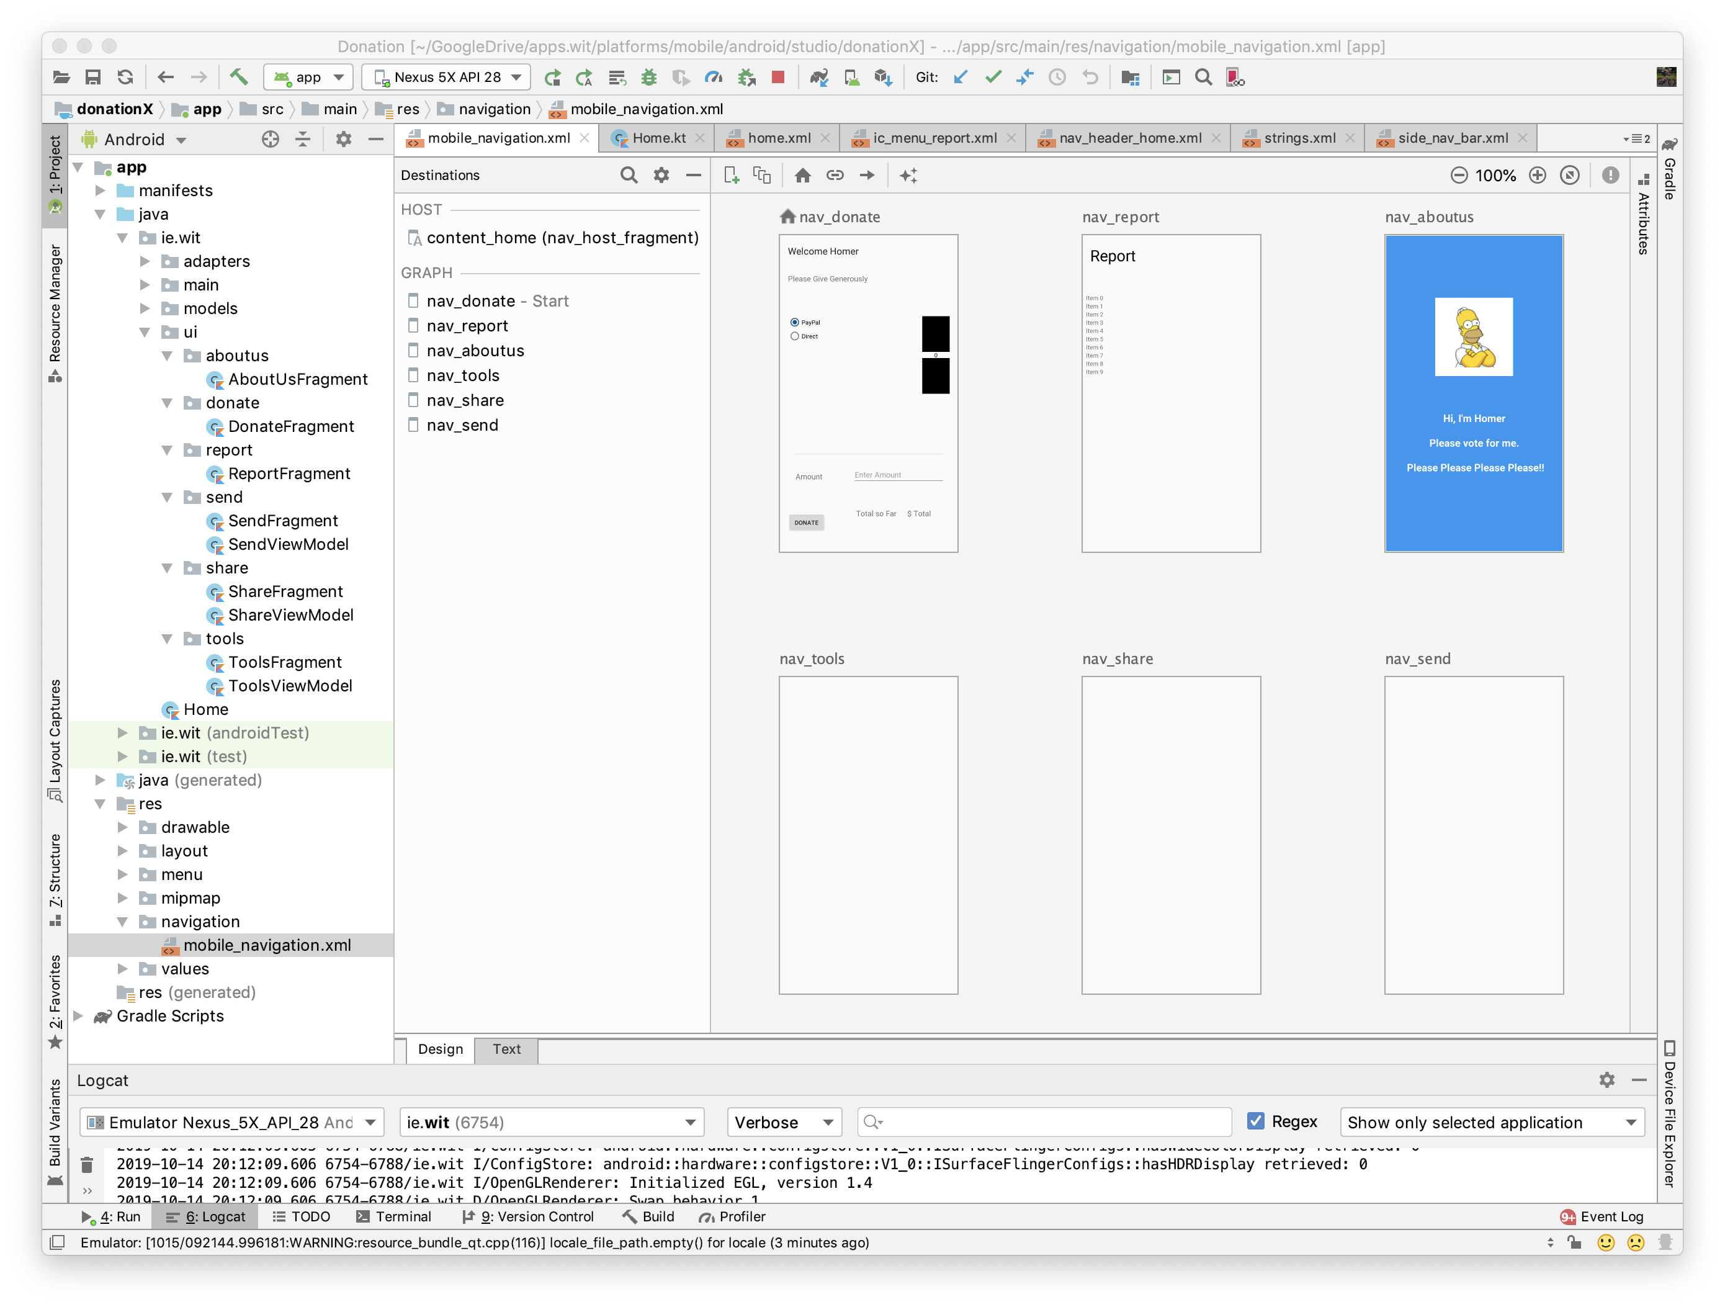
Navigation Graph
Navigation destinations & actions

Slide 32
Source Code Solution available at end of Lab K07a

Slide 33

References
Sources: https://blog.mindorks.com/android-navigation-drawer-in-kotlin
https://medium.com/@umang.burman.micro/navigation-drawer-with-navigation-component-4f032bfdeae6
https://developer.android.com/guide/navigation
https://medium.com/@myric.september/navigation-in-android-navigation-architecture-component-a1f103a6cc52
https://material.io/components/navigation-drawer/#

Slide 34


